Slide 1






AMAZON SALES DATA ANALYSIS REPORT
Bhuvan Shankar Jakkala

Slide 2

Problem
Objective
Sales management has gained importance to meet increasing competition and the need
for improved methods of distribution to reduce cost and to increase profits. Sales management today is the most important function in a commercial and business enterprise.
Benefits
Help out to make better business decisions.
Help analyze customer trends and satisfaction, which can lead to new and
Statement
Develop a Report by Extracting-Transforming- Loading of data which contains Sales trend with respect to Year, Month, Quarter and find Some relationships through data to understand and Analyze the Facts.
better products and
of
for
services.
•
Gives better insight
customers base.
•
Helps in easy flow
managing resources.

Slide 3
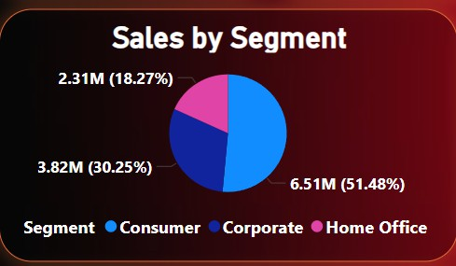
Sales By Segment

Slide 4
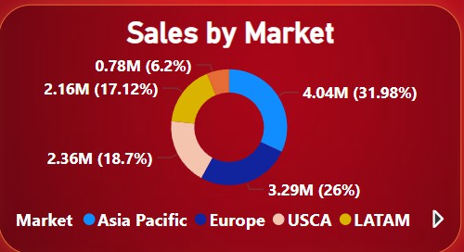
Sales By Market

Slide 5
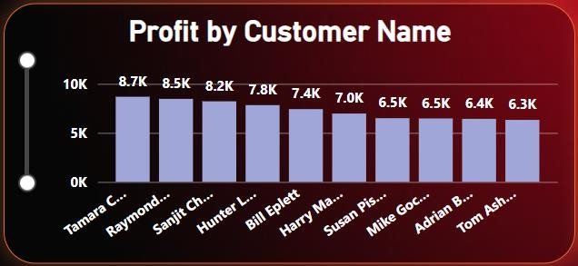
Profit By Customer Name

Slide 6
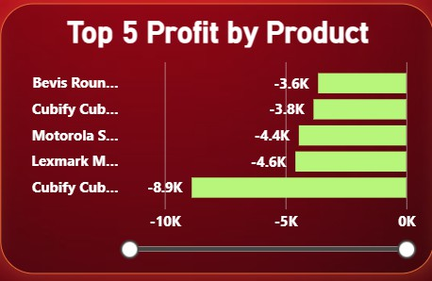
Top 5 Profit By Products

Slide 7

Bottom 5 Profit By Products

Slide 8
Conclusion
Enhanced Sales Insights: The dashboard provides detailed insights into Amazon's global sales performance, helping to identify top-performing products and regions.
Customer Demographics Analysis: Understanding customer demographics and purchasing behavior enables targeted marketing strategies and improved customer engagement.
Interactive and Dynamic Visualizations: Power BI's interactive features allow users to dynamically explore data, facilitating deeper analysis and better decision- making.
Data-Driven Decisions: The comprehensive analysis and visualizations support data-driven decision-making, leading to optimized sales strategies and increased revenue.
Real-Time Data Updates: With the Power BI Service, stakeholders can access up- to-date sales data, ensuring timely and accurate reporting.
Scalability and Collaboration: The project demonstrates how Power BI can scale to handle large datasets and support collaboration across teams through shared dashboards and reports.

